Slide 1
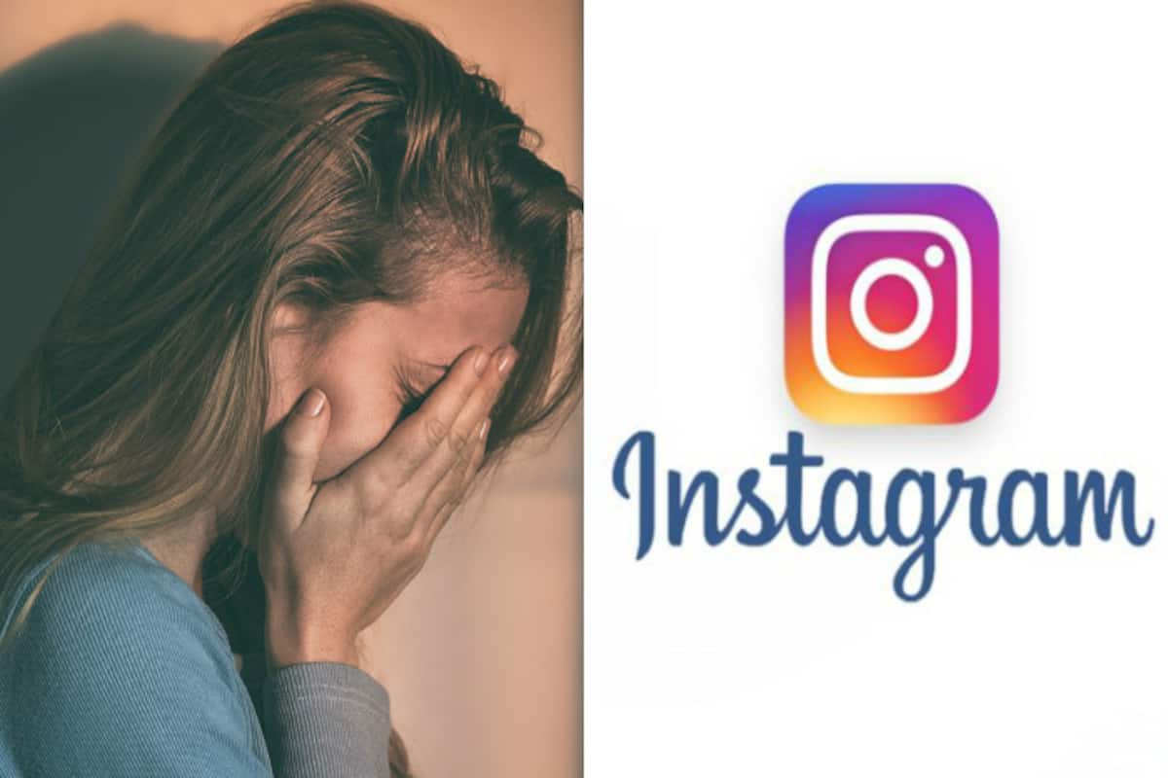
Detection Of Depression From Instagram Posts - Detailed Presentation
By- Vipanchi Katthula
Akshaya Sivakumar Karunambika
Mahesh R
Akanksha Gautam

Slide 2

Project Objectives
Objective 1 :
To identify markers of PTSD from Instagram posts (caption + image).
Objective 2 :
To identify potential individuals suffering from PTSD based on their Instagram posts (caption + image).

Slide 3
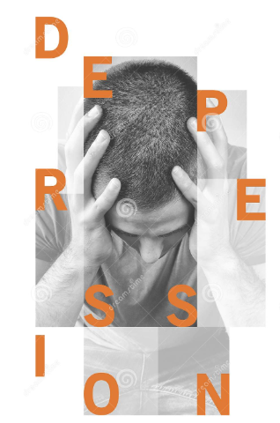
Depression??!!
Losing a loved one, getting fired from a job, going through a divorce, and other difficult situations can lead a person to feel sad, lonely and scared.
In the case of individuals who are diagnosed with depression as a psychiatric disorder, the manifestations of the low mood are much more severe and they tend to persist.
In 2015, around 16.1 million adults aged 18 years or older in the U.S. had experienced at least one major depressive episode in the last year, which represented 6.7 percent of all American adults.
Depression is the leading cause of disability in the United States among people ages 15-44

Slide 4
Type Of Depression
There are different types of depressive disorders, and while there are many similarities among them, each depressive disorder has its own unique set of symptoms
For our project , we are focusing only on Post Traumatic Stress Disorder(PTSD)

Slide 5
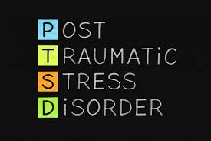
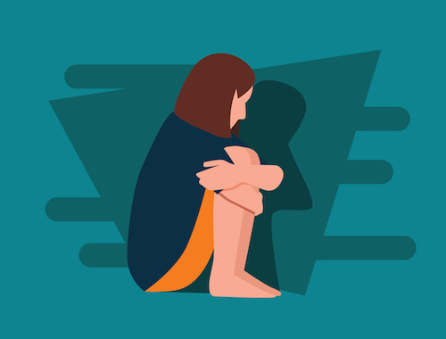
Depression - PTSD
PTSD can occur in all people, in people of any ethnicity, nationality or culture, and any age.
PTSD affects approximately 3.5 % of U.S. adults, and an estimated 1 in 11 people will be diagnosed with PTSD in their lifetime.
Women are twice as likely as men to have PTSD.

Slide 6
Reference
https://epjdatascience.springeropen.com/articles/10.1140/epjds/s13688-017-0110-z
There was a study done in August,2017 where using Instagram data from 166 individuals, they applied machine learning tools to successfully identify markers of depression
Statistical features were computationally extracted from 43,950 participant Instagram photos, using color analysis, metadata components, and algorithmic face detection.

Slide 7

Reference Paper Hypothesis
Hypothesis 1- Instagram posts made by individuals diagnosed with depression can be reliably distinguished from posts made by healthy controls, using only measures extracted computationally from posted photos and associated metadata.
Hypothesis 2-Instagram posts made by depressed individuals prior to the date of first clinical diagnosis can be reliably distinguished from posts made by healthy controls.
Hypothesis 3a - Human ratings of Instagram posts on common semantic categories can distinguish between posts made by depressed and healthy individuals.
Hypothesis 3b - Human ratings are positively correlated with computationally-extracted features.

Slide 8
Other References
We have also referred to other papers for guidelines for the project.
https://arxiv.org/ftp/arxiv/papers/1607/1607.07384.pdf
https://www.jmir.org/2019/6/e14199/
https://psychcentral.com/news/2018/07/22/risk-for-ptsd-varies-by-gender-age/15875.html
https://www.nimh.nih.gov/health/statistics/mental-illness.shtml
American Psychiatric Association:
https://www.psychiatry.org/patients-families/ptsd/what-is-ptsd
US department of Veterans Affairs: https://www.research.va.gov/topics/ptsd.cfm

Slide 9
Data Collection - Reference Paper
Data collection was crowdsourced using Amazon’s Mechanical Turk (MTurk) crowdwork platform.
Separate surveys were created for depressed and healthy individuals.
In the depressed survey, participants were invited to complete a survey that involved passing a series of inclusion criteria, responding to a standardized clinical depression survey, answering questions related to demographics and history of depression, and sharing social media history.
Qualified participants were asked to share their Instagram usernames and history

Slide 10

Project Tasks
Data collection
Scraping Instagram data for all the identified usernames
Data cleaning
Identifying clean posts and images that are related to ptsd/depression
Data Labelling
Google auto ML image classification.
Model training/Validation
Identify the characteristics of captions and images posted by a PTSD diagnosed person
Identify based on posts if a person might be suffering from PTSD
Final Analysis and documentation

Slide 11
Conceptual Diagram
Image Features
HueMean
HueMax
HueMin
SaturationMean
SaturationMax
SaturationMin
BrightnessMean
BrightnessMax
BrightnessMin
FaceCountMax
FaceCountMin
FaceCountMean
Photosw/Smile
TotalPhotosw/faces
Caption features
number_of_hashtags
average_hashtags_per_post
number_of_words
average_words_per_post
avg_sentimentpositive
avg_sentimentnegative
avg_sentimentneutral
avg_sentimentcompound
cnt_neg_posts
cnt_neu_posts
cnt_pos_posts
avg_polarity
No_of_Posts
No_of_Followers
Demographic features
Female
AgeCategory

Slide 12

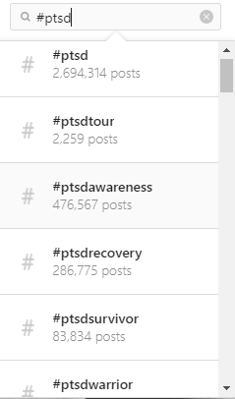
Data Collection
We found 160 people with a total of 97,915 posts suffering from PTSD based their Instagram posts.
We searched using hashtags like #ptsd, #ptsdsurvivors, #ptsdveterans. #ptsdsufferer, #ptsdlife.
We used twitter to find Instagram handles with cases of PTSD.
We searched each profile with these hashtags and then screened all their posts to confirm that the person is suffering from PTSD.
We found that people do not usually mention their diagnosis date in their Instagram posts.

Slide 13
Data Collection
We captured the following from the instagram handles:
HandleName
FullName
Profile type(only public profiles were taken)
# of Followers
# of Posts
Gender
Age Group

Slide 14
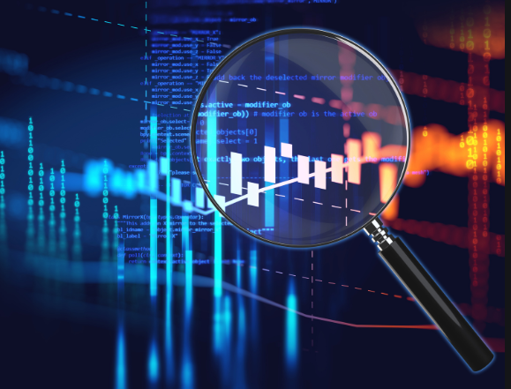
Data Screening
We cross checked the list of Instagram handles collected and took a detailed look at all the posts.
We removed handles which did not have significant number of posts related to PTSD.
Handles were screened for the below reasons
- insignificant number of total posts
- insignificant number of posts related to them/their mental health
- consists of generic posts only
We finally had 100 handles, 50 each in both depressed and non-depressed category which had significant number of posts.

Slide 15
Final Data Collection
We scrapped 50 Instagram handles of people suffering from PTSD and 50 non-depressed people.
Total of 43,256 posts
Posts of Depressed people : 23,119
Posts of Non-depressed people : 20,137
Scraped data into separate folders for each user containing images and captions of all posts.
We then manually checked and handpicked only PTSD related posts from a person’s scrapped data for feature extraction.

Slide 16
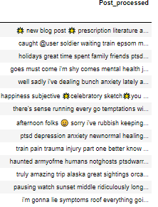
Data cleaning
We split the data into images and text files(captions).
Converted text to lower-case
We removed stop words (nltk), @user
Replaced Hashtag with “”
Removed https:// links

Slide 17
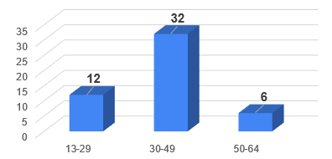
Exploratory Analysis
Minimum Age requirement for Instagram: 13 years
We identified the below Age Categories by taking a social media study as reference:
13-29, 30-49, 50-64, 65+
Noticed that 65+ age group is less common on instagram.
Could not identify depressed subjects in 65+ age group.

Slide 18
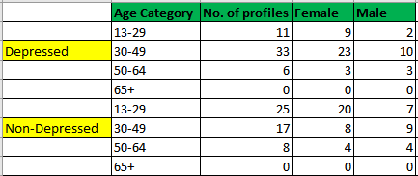
Exploratory Data Analysis
Using MATCHED PAIRS, the user profiles were picked for the analysis.
The distribution of gender and age group was maintained same for Depressed and Non-depressed
Depressed:
Female: 35, Male: 15
Non-Depressed:
Female: 30, Male: 20

Slide 19
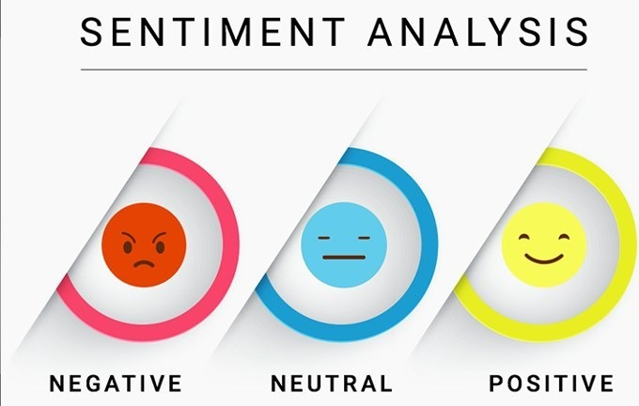
Sentiment Analysis
Sentiment score calculated using Python’s NLTK VADER
Positive ,negative ,neutral scores and compound scores for each post and aggregated for each user.
If compound value >0.05 ⇒ positive or
compound value <-0.05==>negative else neutral
The below fields were derived for each user
Count of positive/negative/neutral posts
Average positive/negative/ neutral/compound Sentiment
All these measures are significant : t-test resulted with p-value lower than 0.05

Slide 20
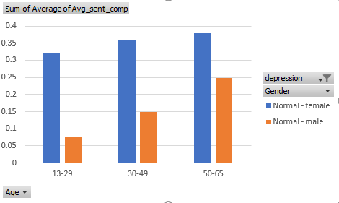
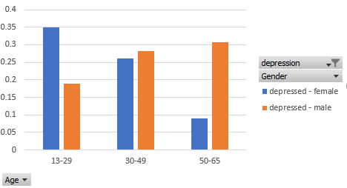
Sentiment Analysis-Findings
The compound sentiment score for depressed people decreases with age for females and increases with age for males which indicates that women are likely to get more negative with age.
In normal people , The trend shows that both men and women get more positive with age indicating young adults are most negative in their posts.
To see the age and gender wise count split up please refer slide 18.
Package:NLTK(lexicons), SentimentIntensityAnalyzer from NLTK.Vader
Software: Python, Code File: TextAnalysis.ipynb

Slide 21
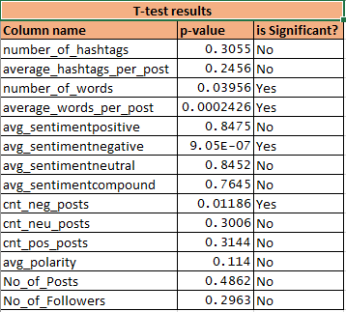
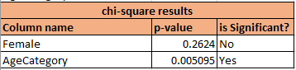
Exploratory Analysis - Text
t-test was performed for all the numeric text features with the target variable.
Chi-square test for two factor variables Female and AgeCategory resulted in AgeCategory as a significant variable.
T-test and chi-square tests were performed in R using t.test and chisq.test functions

Slide 22
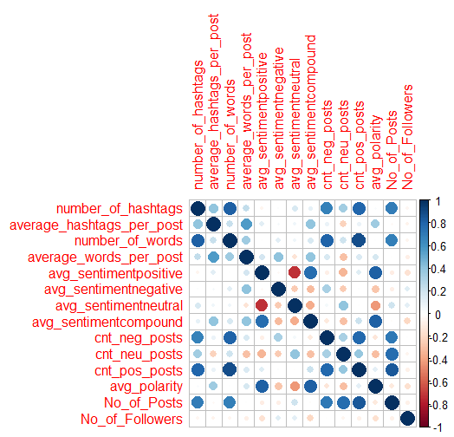
Exploratory Analysis - Text
Correlation matrix was created in R using corrplot package
Correlation matrix is present in Appendix sheet A2.
The mean,SD,Min,Max for each numerical field is found and is present in the Appendix sheet A1.

Slide 23
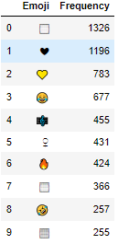
Text Analysis
Dark humor was highly prevalent in the posts of the depressed individuals.
Depressed subjects also post empathetic posts to express their thoughts.
Commonly used emojis by depressed users:
-> Sad, Dark Humor
-> Empathy & Friendship
Package: Emoji, Software: Python, Code File: TextAnalysis.ipynb

Slide 24
Bag of Words
The most frequent words used by the depressed subjects were:
Mentalhealth, Trauma, Ptsd, one , Survivor, Time, feel
The choice of words was significantly different for depressed and non-depressed individuals. So, we decided to analyse the word clouds by considering the two groups separately.

Slide 25
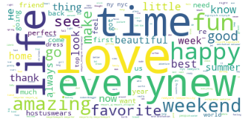
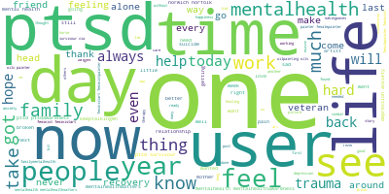
Word Cloud - Normal vs Depressed
For Normal people, sentiment distribution is
negative -17%,
neutral-42%
positive-49%
For Depressed people, sentiment distribution is
negative -38%,
neutral-16%
positive-44%

Slide 26
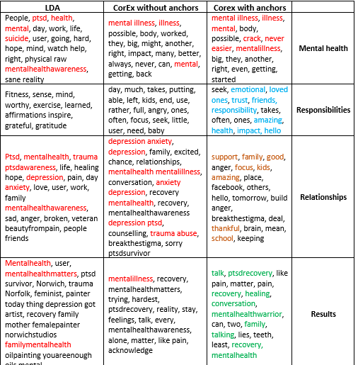
Anchor Word
Algorithm
Applying unsupervised LDA algorithm did not make sense as the identified topics were highly overlapping.
Semi-supervised approach using CorEX algorithm provided better results compared to LDA but the results were incomprehensible for certain topics.
An attempt to identify 4 topics resulted in a very higher level topics mentioned below :
Mental Health
Responsibilities
Relationships
Results
Package: PyLDAvis, Software: Python, Code File: TextAnalysis.ipynb

Slide 27
Supervised - CorEx Algorithm
We selected the following 5 topics using the references given below.
Causes: accidents, assault, abuse, trauma, war, loss, torture, combat, harass
Symptoms: anxiety,depression,insomnia,irritability,stress,flashbacks,anger,drug abuse, alcohol abuse
Coping mechanisms: positive, meditation, love, family, support, art
Treatment options: therapy, paroxetine, sertraline, Amitriptyline, phenelzine, antidepressant, medicine
Physical: pain, sweat, sick, tremble, harm, drug, alcohol, dizzy, ache
References:
American Psychiatric Association: https://www.psychiatry.org/patients- families/ptsd/what-is-ptsd
US department of Veterans Affairs: https://www.research.va.gov/topics/ptsd.cfm
Package: corextopic, Software: Python, Code File: TextAnalysis.ipynb

Slide 28
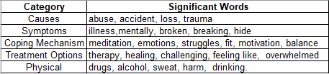
Anchor - Word Output
Clearly the results of the supervised CorEx were more comprehensible and were conveying the story of a patient with depression.
Text analysis of instagram posts using the Supervised CorEx algorithm revealed that Causes of depression were abuse, accident, loss and trauma.
The Symptoms of depression were illness,mentally, broken, breaking and hiding.
The Coping Mechanisms of the depressed were doing meditation, expressing emotions and struggles, getting fit, motivation and maintaining balance.
The Treatment options used by the individuals were expressed by the use of words like therapy, healing, challenging, feeling like and overwhelmed.
The Physical symptoms of depression were identified to be drugs, alcohol, sweat, harm and drinking.

Slide 29
Key Variables and Their Operationalization
Based on the Logistic Regression output, the key variables to identify a depressed person from text was the average number of words.
The choice of emojis was also different as there were black love and yellow love emojis that were used more by depressed individuals.
On average, the percentage of posts with positive sentiment were similar for Depressed and Non-depressed. However, the proportion of negative posts are higher for Depressed making the overall sentiment negative.

Slide 30
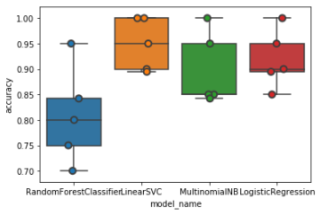
Support Vector Classifier Model
Ran 5 Fold cross validation on text with 10,695 features for 100 users.
Linear SVC gave the best accuracy and recall to identify the users.
Training Data-
92.895% - Accuracy
98% - Precision
92% - Recall
Test Data-
89% - Accuracy
85% - Precision
85% - Recall
Package: sklearn.LinearSVC
Software: Python,
Code File: TextAnalysis.ipynb

Slide 31
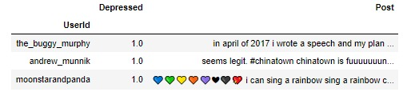
Model Result analysis
All the text models have constantly misidentified the below three users as non-depressed because :
Average Negative Polarity similar to non-depressed
High average number of words (>54 words)

Slide 32
Image Analysis
We analyzed the images using face detection and color detection methods to extract features.
Three color properties commonly used in Image Analysis, Hue, Saturation and Value were extracted.
Hue describes an image’s coloring on the light spectrum (ranging from red to blue/purple).
Saturation refers to the vividness of an image. Low saturation makes an image appear grey and faded.
Value refers to image brightness. Lower brightness scores indicate a darker image.

Slide 33
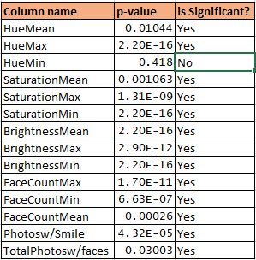
Exploratory Analysis - Image
Maximum minimum and mean values for Hue Saturation and Brightness were extracted.
Facecount in each image with people were found
T test was run on each of the feature with the target variable to test significance
Most of the variables turned out to be significant variables.

Slide 34
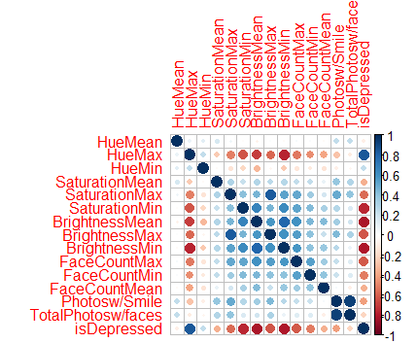
Exploratory Analysis - Image
Correlation plot was created using corrplot in R
The plot shows significant correlation between the target variable and Saturation and brightness variables.
Mean,SD,Min,Max for each numerical field is found and is present in Appendix sheet A7

Slide 35
Image Analysis findings
Image Features(HSV) for Depressed and Normal people were obtained:
Brightness and Saturation are low in depressed people images compared to normal people.
Average face-count for depressed people are 2 and for normal are 7.
Normal people post images with smiles more than depressed people, on an average of 800/1000 posts for normal people and 450/1000 people for depressed people.
Feature | Depressed | Normal
Average Hue | 58.47 | 44.47
Average Saturation | 81.15 | 156.44
Average Brightness | 138.87 | 201.37
Huemax | 149.54 | 93.54
Huemin | 8.644 | 8.208
Saturation Max | 179 | 227.442
Saturation Min | 13.57 | 59.453
Brightness Max | 211.054 | 242.881
Brightness Min | 52 | 112.443

Slide 36
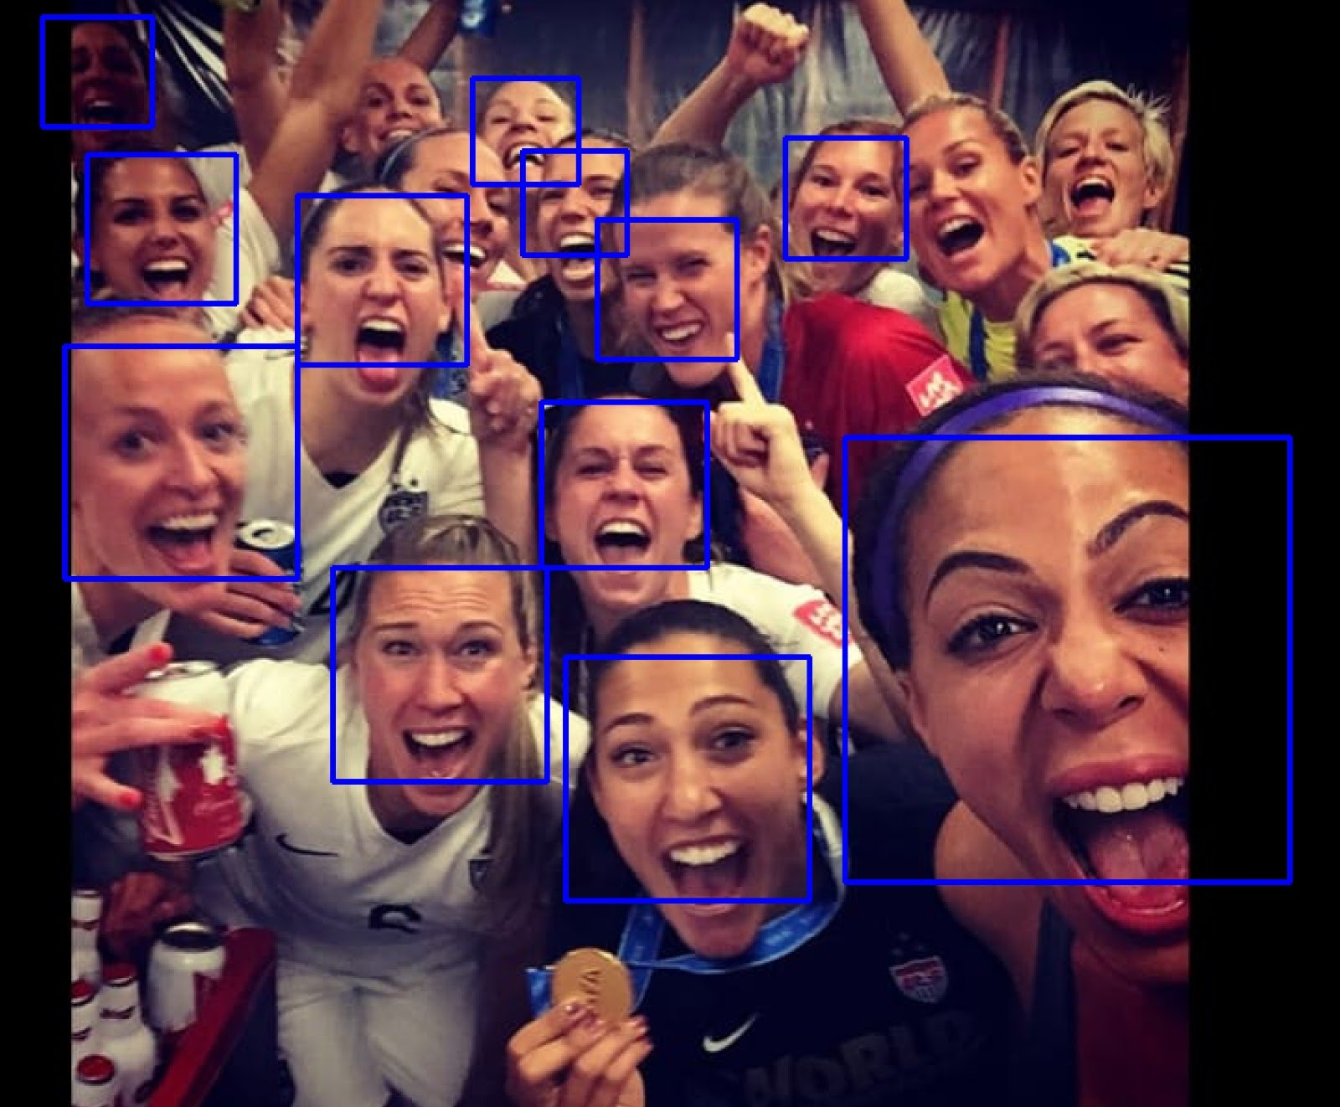
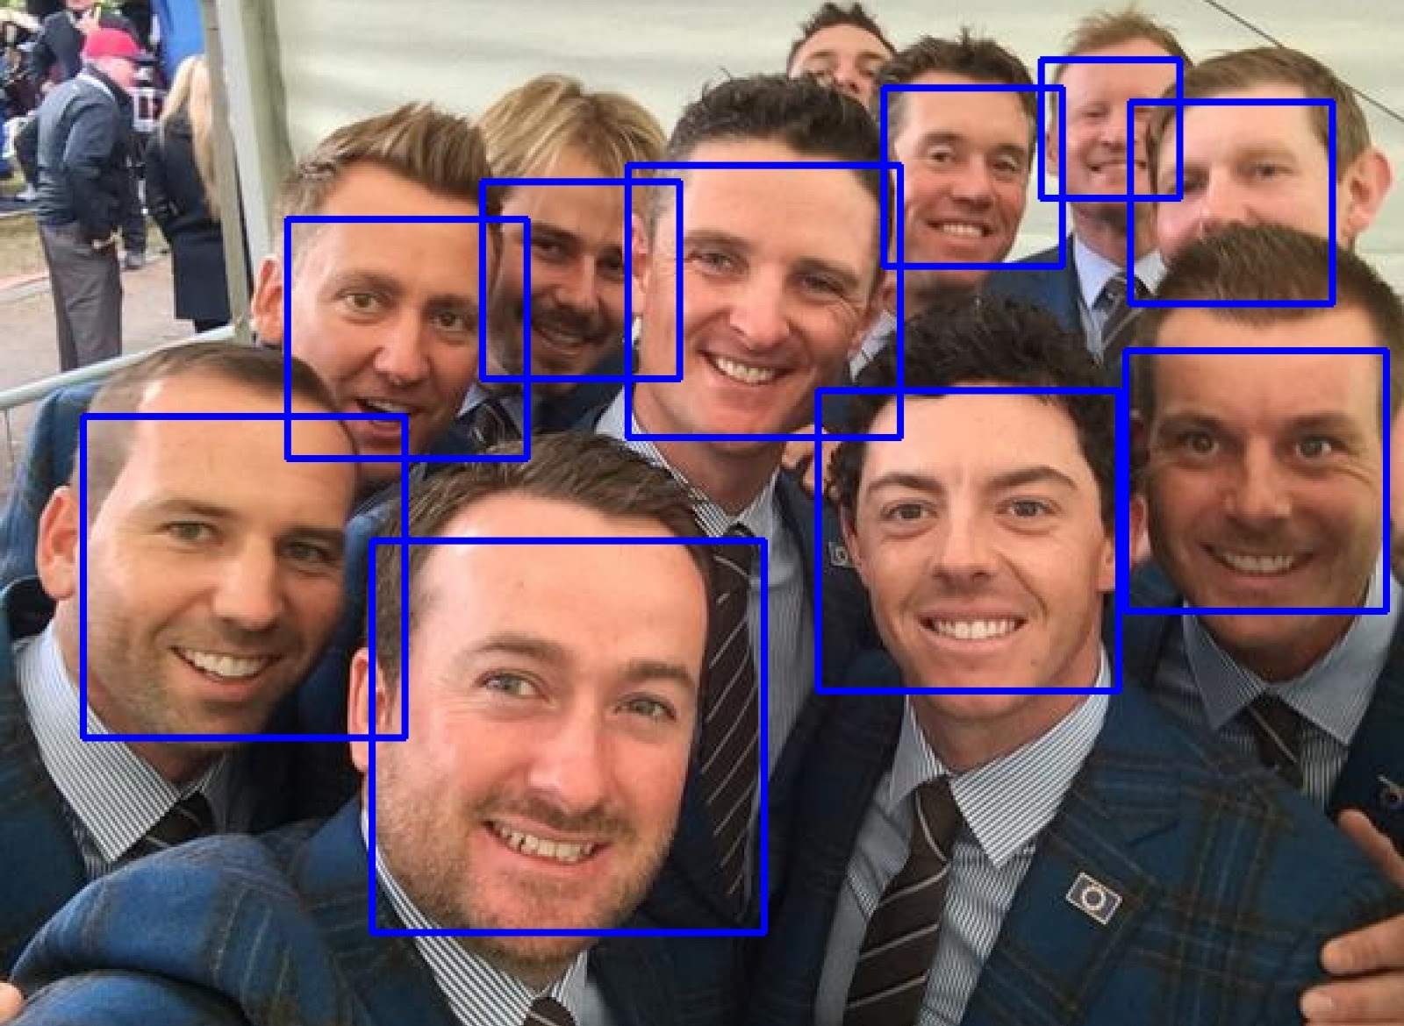
Face detection using openCV and python
Face detection algorithm was run on multiple images to identify number of faces.
Maximum number of faces the algorithm detected was 14.
openCV library with Haar Cascade Implementation for detecting faces was used.
A maximum of 21 faces were recognized correctly.

Slide 37
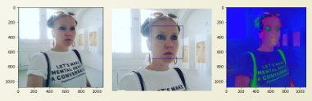
Feature Extraction
We used openCV and Python to perform the image analysis and detect faces.
Pixel-level averages were computed for Hue, Saturation, and Value (HSV).
Normal ranges for HSV in openCV are Hue(0-180), Saturation and Value(0-255).
Example to show the HSV scale with values 37.26057442, 32.79710562, 183.72624829.

Slide 38
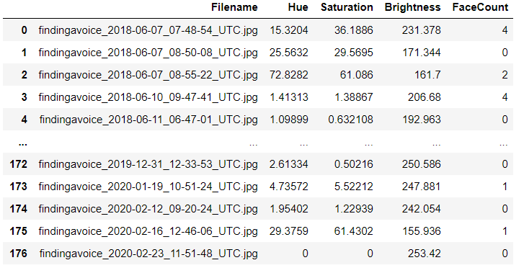
Feature Extraction
We have added Hue, Saturation, Value and Face count as features into building the model.
Each of the row corresponds to each photo the profile owner has posted and the features are extracted from every single image.
After extracting features for all images across all profiles, the files are grouped per user and the mean , maximum and minimum are calculated for HSV and FaceCount.

Slide 39
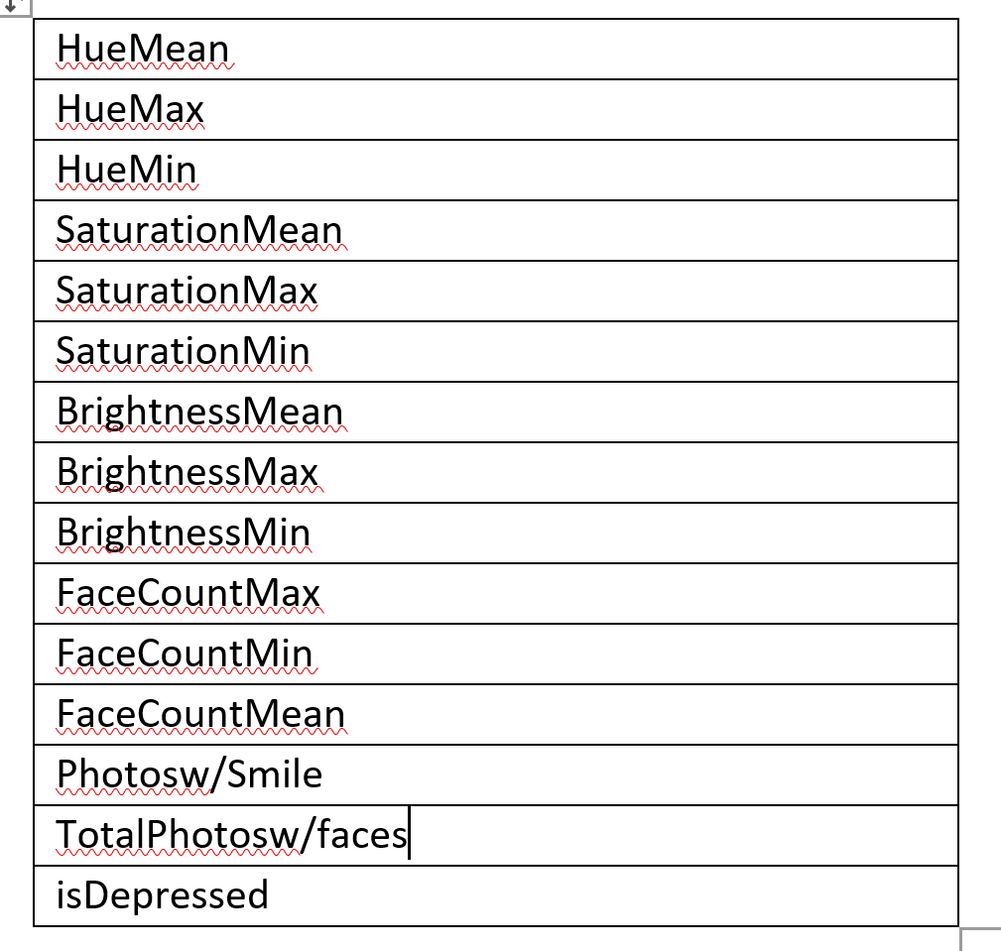
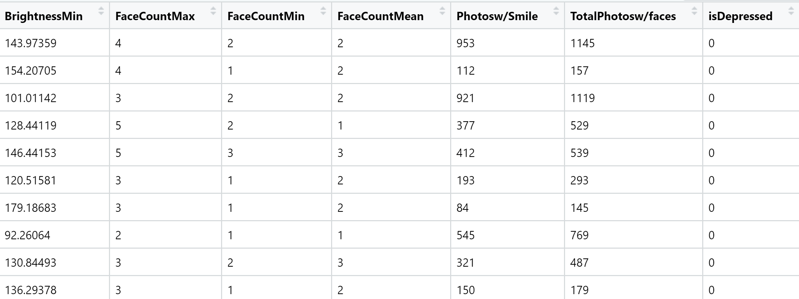
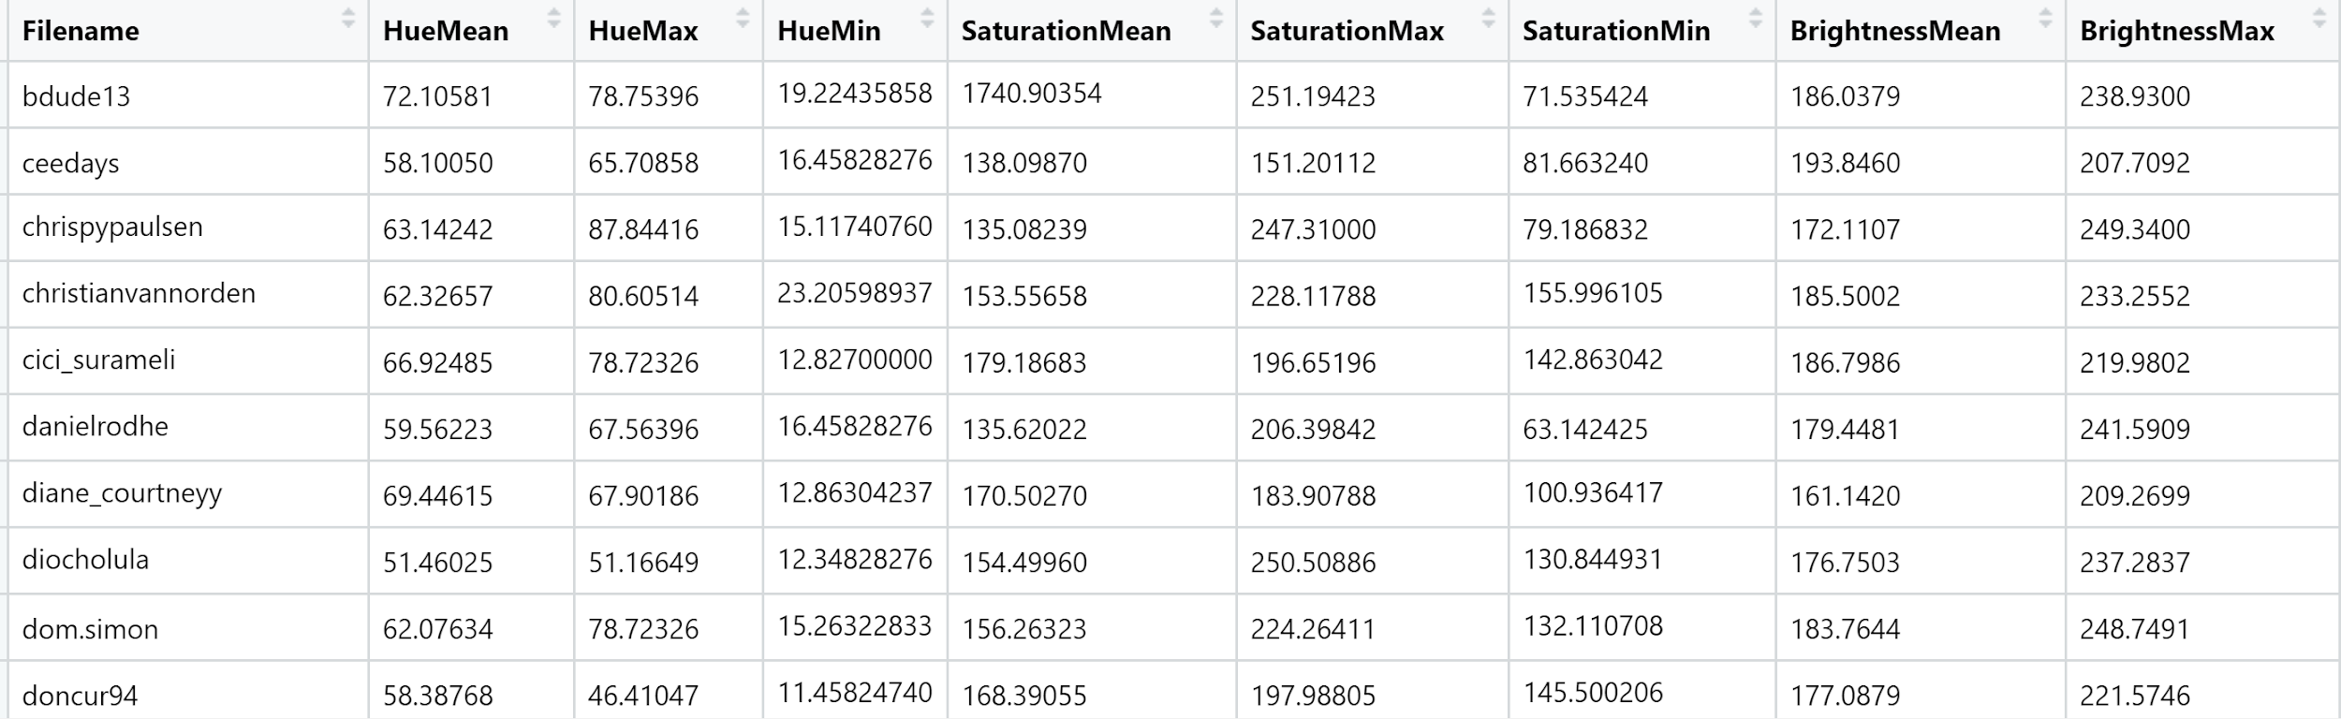
Key Variables and Their Operationalization
Maximum minimum and mean values for Hue Saturation and Brightness were extracted.
Facecount and photos with smile were counted and compared with total photos containing faces.
The final dataset looks like this. It has the following variables- Hue(Mean. Min and Max), Saturation( Mean, Min and Max) , Brightness(Mean, Min and Max), FaceCount(Mean, Min and Max), Photos with smile and Total photos with faces. IsDepressed is the Target Variable.

Slide 40
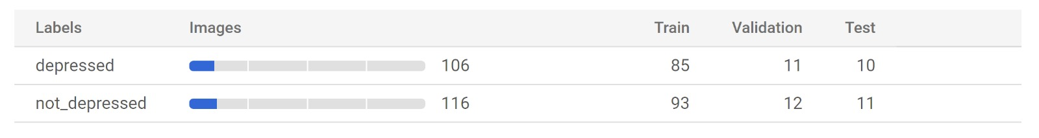
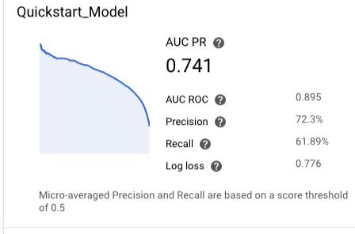
Image Classification with Google AutoML using Vision API
Configured Google AutoML and enabled Vision API for image classification.
Formed a bucket with two groups of images, depressed and non-depressed.
Created a dataset and applied the labelling for training the model by adding the bucket created.

Slide 41
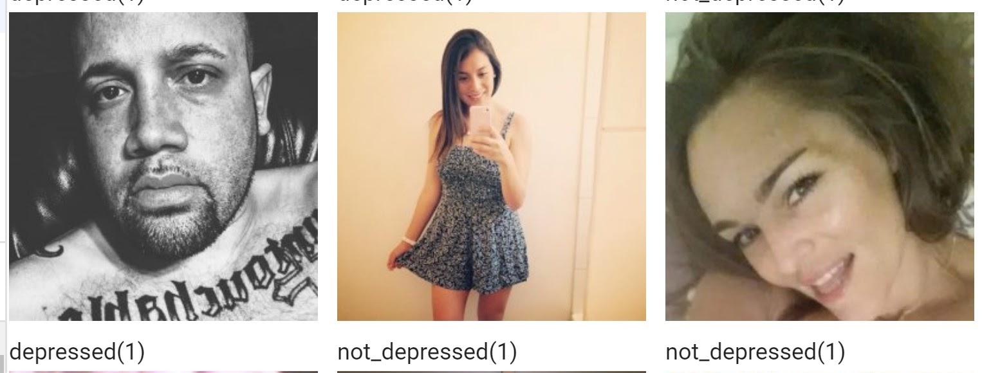
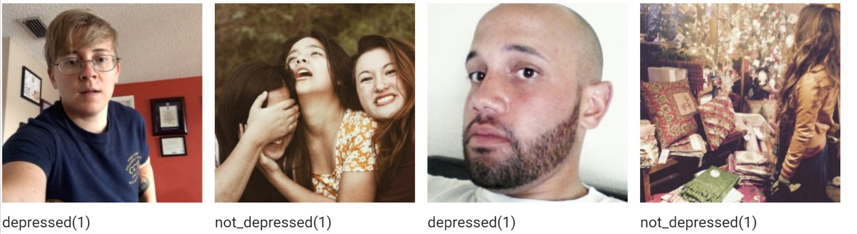
Image Classification Results

Slide 42
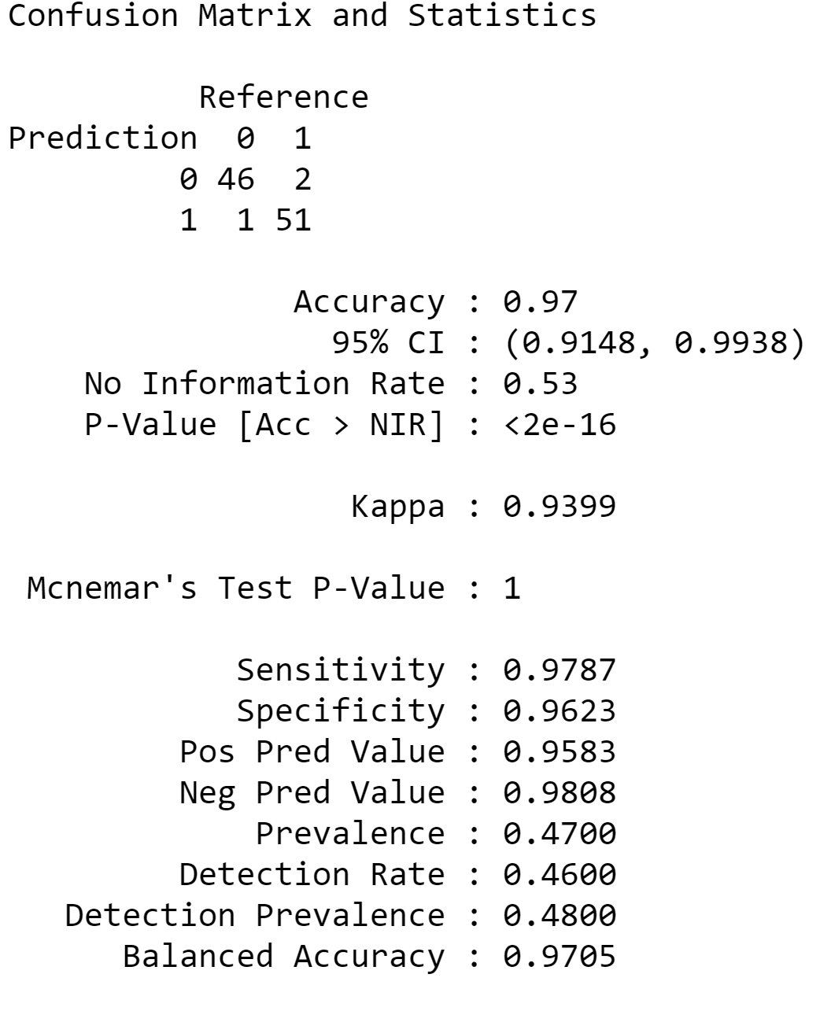
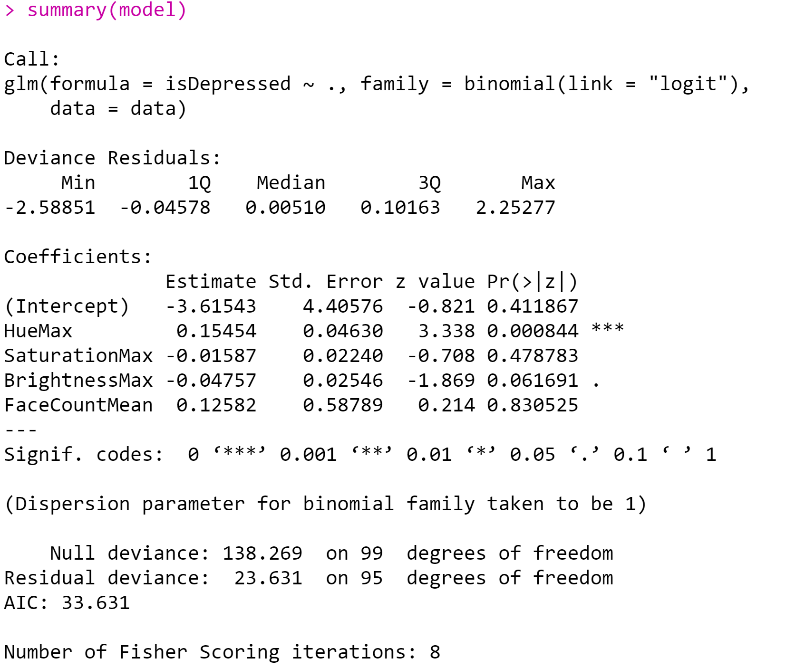
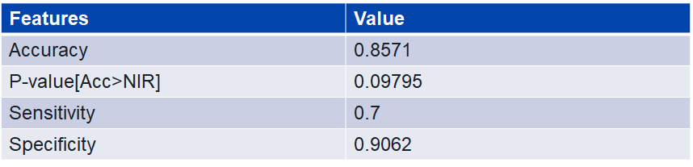
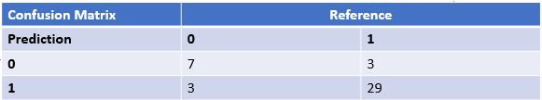
Logistic Regression(Images)
Accuracy obtained : 97.00%

Slide 43
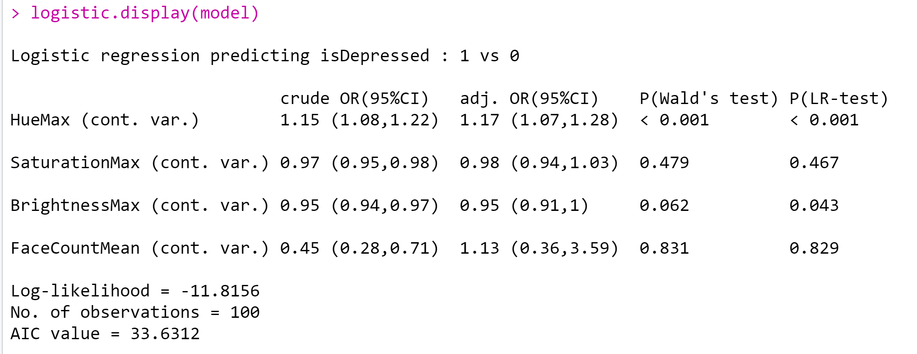
Image Analysis Findings
Depressed people relative to happy, normal people have 17 % more hue in their images and 5% less brightness overall.

Slide 44
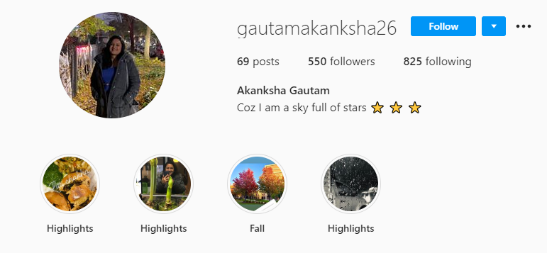
Model Testing On Our Team
Used our own Instagram accounts as test data
Model predicted that Akanksha was depressed based on her posts

Slide 45
Interesting Findings
We could not find any public profile for age group 65+ in the depressed category.
Male public profiles are lower than that of female profiles in depressed people.
Women are more expressive about their mental health than men.
The average number of photos with people and the number of faces in each image were less for depressed people as compared to normal people.

Slide 46
Findings and Conclusions
Text analysis of instagram posts using the Supervised CorEx algorithm revealed that Causes of depression were abuse, accident, loss and trauma.
The Symptoms of depression were illness,mentally, broken, breaking and hiding.
The Coping Mechanisms of the depressed were doing meditation, expressing emotions and struggles, getting fit, motivation and maintaining balance.
The Treatment options used by the individuals were expressed by the use of words like therapy, healing, challenging, feeling like and overwhelmed.
The Physical symptoms of depression were identified to be drugs, alcohol, sweat, harm and drinking.

Slide 47
Findings and Conclusions
Image analysis revealed that the average Hue value for Happy people was found to be lesser than depressed people, indicating that images of depressed people were more blue and images of happy people were more red(P<2.2e-16, depressed -124, non-depressed - 65.3).
Happy people had more gray and faded images as compared to depressed people(P<1.319e-09).
Happy people posted brighter images than depressed people who posted images which were dull and sometimes blurred and darker(P<2.8e-12).
Facecount was on average 1 or 2 for depressed people as compared to an average of 4 for happy people who loved posting in groups quite often(P<0.01).
Only 1 out of 15 photos had smiling faces in the depressed category as compared to 1 out every 3 photos for non-depressed profiles(P<0.01)

Slide 48
Findings Compared to Other Studies
Elklit and Daniel N. Ditlevsen, from the University of Southern Denmark and Odense University Hospital, Denmark, collected data from 6,548 participants in previous Danish or Nordic PTSD studies in order to investigate the gender difference in the lifespan distribution of PTSD.
Danish researchers discovered men are most vulnerable to PTSD between the ages of 41 and 45 years, while women are most vulnerable at ages 51 to 55. This supports previous research that has shown that men and women show differences in the age distribution of post-traumatic stress disorder (PTSD) prevalence during their lifespan.
This research finding matches with our below findings (Refer slide 20)
The compound sentiment score for depressed people decreases with age for females and increases with age for males which indicates that women are likely to get more negative with age.
Reference Link:
https://psychcentral.com/news/2018/07/22/risk-for-ptsd-varies-by-gender-age/15875.html

Slide 49
Findings Compared to Other Studies
As per the National Institute of Mental Health,
Young adults aged 18-25 years had the highest prevalence of AMI (25.8%) compared to adults aged 26-49 years (22.2%) and aged 50 and older (13.8%).
This is in sync with our findings (Refer slide 20)
The trend shows that both men and women get more positive with age indicating young adults are most negative in their posts.
Reference link:
https://www.nimh.nih.gov/health/statistics/mental-illness.shtml

Slide 50
THANK YOU

